Slide 1
Telco Customer Churn Analysis Business Analytics Case Study
BENEDICTA IZEGBUE
BUSINESS AND FINANCIAL ANALYST

Slide 2
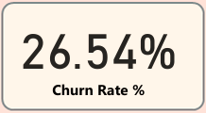
Business Problem Statement
Business Challenge
Customer churn is one of the biggest challenges in the telecommunications industry. Every customer lost represents lost revenue, increased acquisition costs, and reduced customer lifetime value.
Key Questions
Why are customers leaving?
Which customer segments are most likely to churn?
Which business factors influence churn?
How can retention be improved?
Project Goal
Use customer data to identify churn drivers and provide recommendations that support customer retention and business growth.

Slide 3
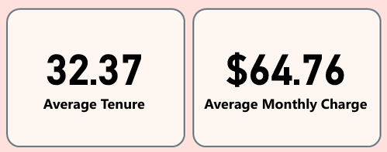
DATASET OVERVIEW
Dataset Description
The Telco Customer Churn dataset contains customer demographic information, service subscriptions, billing details, and churn status.
Dataset Summary
KPIs | Value
Total Records | 7,043
Total Customers | 7,043
Churned Customers | 1,869
Active Customers | 5,174
Churn Rate | 26.54%

Slide 4
DATASET OVERVIEW
Key Variables
Gender
Senior Citizen
Partner
Dependents
Contract Type
Internet Service
Payment Method
Monthly Charges
Total Charges
Tenure
Churn
Data Preparation
Checked data quality
Created tenure groups
Created monthly charge bins
Developed churn measures using DAX
Created correlation heatmap

Slide 5
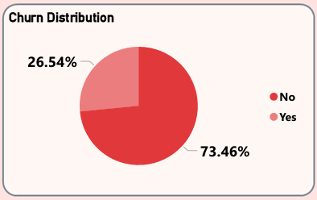
EXECUTIVE OVERVIEW FINDINGS
Overall Churn Performance
Key Findings
Overall churn rate is 26.54%.
Approximately 1 in 4 customers have left the company.
Active customers account for the majority of the customer base.
Customer retention remains a significant business challenge.
BUSINESS IMPLICATION: Reducing churn by even a small percentage could generate substantial revenue retention.

Slide 6
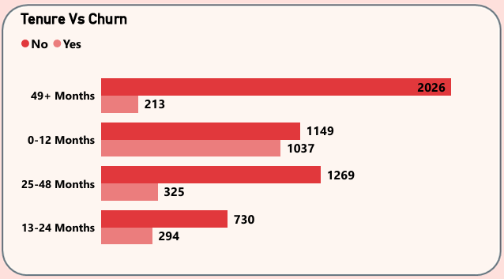
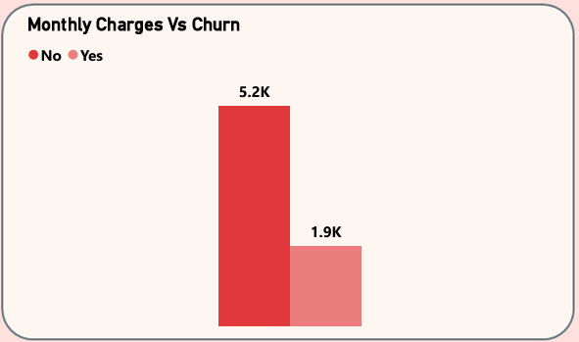
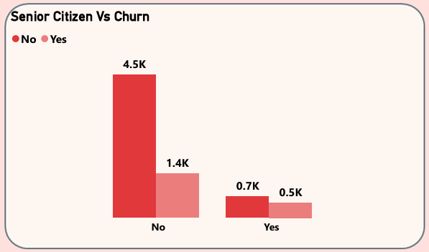
CUSTOMER ANALYSIS
Which Customers are leaving?
Findings
Tenure
Customers with shorter tenure exhibit significantly higher churn.
Long-term customers demonstrate greater loyalty.
Monthly Charges: Customers paying higher monthly fees are more likely to leave.
Senior Citizens: Senior citizens show slightly higher churn rates compared to non-senior customers.
BUSINESS IMPLICATION: New customers and high-charge customers require proactive retention strategies.

Slide 7
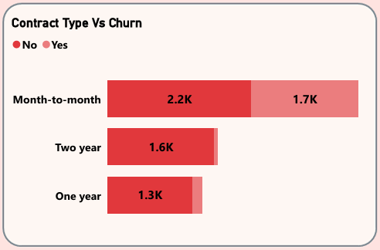
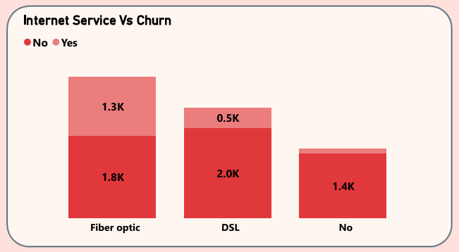
SERVICE AND CONTRACT ANALYSIS
Which Customers are leaving?
Findings
Contract Type
Month-to-Month contracts have the highest churn rate.
Two-Year contracts have the lowest churn rate.
Internet Service
Fiber Optic customers experience the highest churn.
DSL and No Internet customers demonstrate stronger retention.
BUSINESS IMPLICATIONS: Contract commitment and service experience strongly influence customer retention.
.

Slide 8
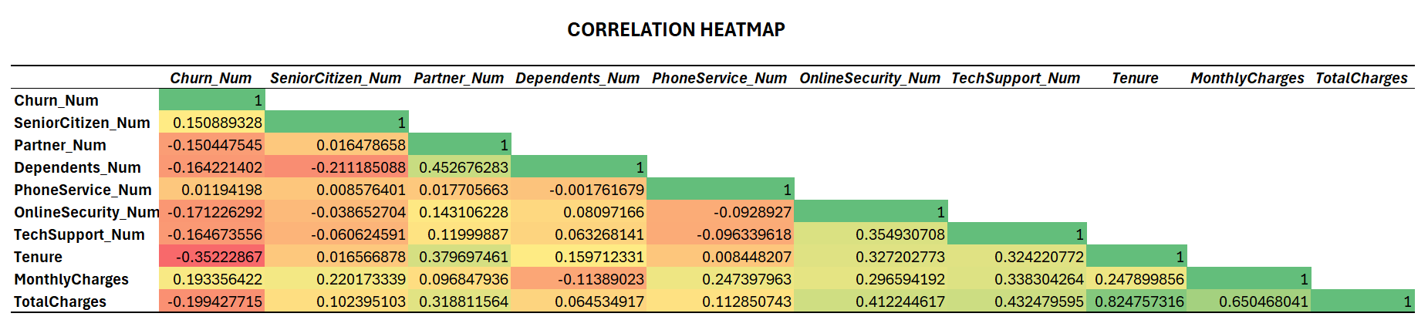
CHURN DRIVERS AND CORRELATION ANALYSIS
What Drives Customer Churn?
Correlation Findings
Key Insights
Longer-tenure customers are less likely to churn.
Customers paying higher monthly charges are more likely to leave.
Customers using Online Security and Tech Support remain loyal.
Family-oriented customers demonstrate lower churn risk.
BUSINESS IMPLICATIONS
Customer value perception and service engagement are factors.
.
Variable | Relationship with Churn
Tenure | Strong Negative
Monthly Charges | Positive
Online Security | Negative
Tech Support | Negative
Partner | Negative
Dependents | Negative

Slide 9
RECOMMENDATIONS
1. Improve New Customer Onboarding
Launch retention campaigns during the first year.
Increase customer engagement after signup.
2. Encourage Long-Term Contracts
Offer discounts for annual plans.
Introduce loyalty rewards.
3. Improve Fiber Optic Customer Experience
Investigate service quality issues.
Address pricing concerns.
4. Promote Value-Added Services
Bundle Online Security and Tech Support.
Increase awareness of service benefits.
5. Review Pricing Strategies
Offer personalized retention incentives for high-charge customers.

Slide 10
CONCLUSION
The analysis reveals that customer churn is primarily influenced by:
Short customer tenure
High monthly charges
Fiber Optic service subscriptions
Lack of value-added services
By focusing on customer retention programs, contract upgrades, service quality improvements, and customer engagement initiatives, the company can reduce churn and improve long-term profitability.
benedictaizegbue6@gmail.com

